Slide 1
Fixed Income Analysis
Qian Han
WISE, Xiamen University
Fall, 2015

Slide 2
Welcome to the Fixed Income World!
Debt
Origin of democracy?
Quite different from stocks
different kinds of interest rates (>100)
different kinds of bonds and derivatives
Different kinds of maturities
A totally different market and industry
Market size
Industry difference

Slide 3
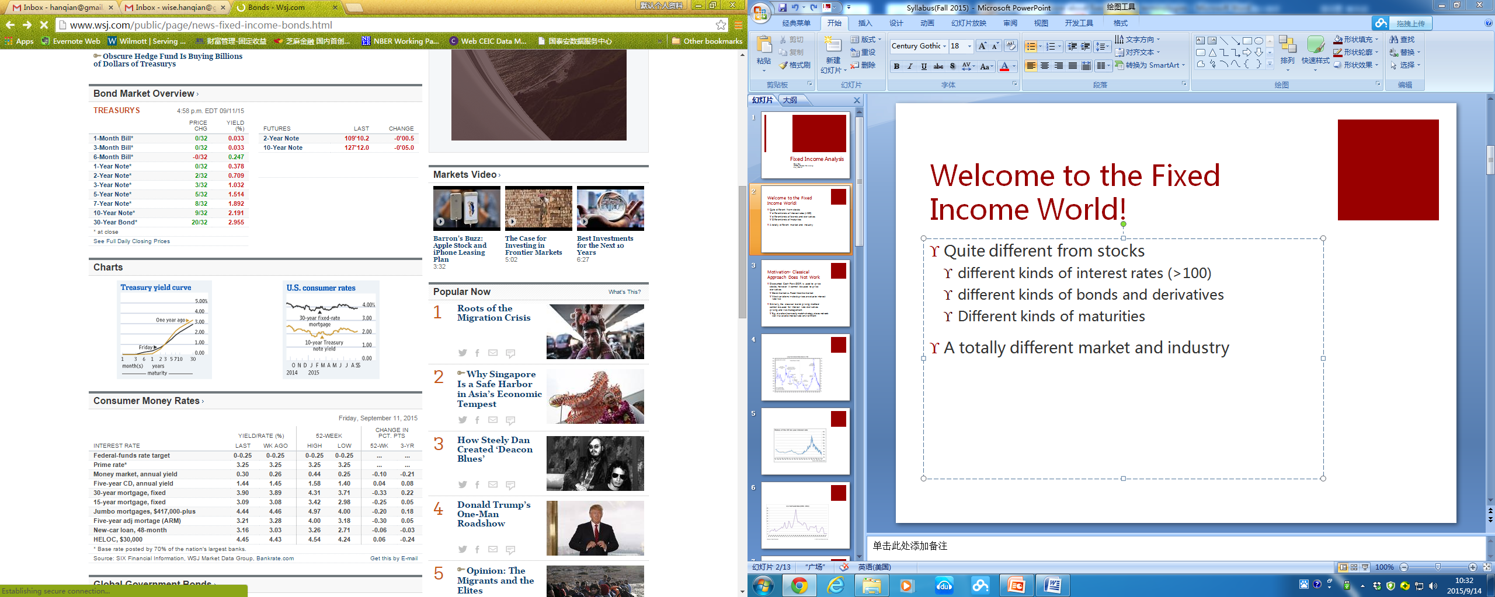

Slide 4
As of 2010, the size of the worldwide bond market (total debt outstanding) is an estimated at $93 trillion, of which the size of the outstanding U.S. bond market debt was $37 trillion according to Bank for International Settlements (BIS).
In 2010, global stock market capitalization stood at $54 trillion, according to the McKinsey Global Institute’s report “Mapping Global Capital Markets 2011.” The market capitalization of the U.S. stock market is about $21 trillion.
Bonds accounted for 75 percent of corporate financing, according to Mark Skousen’s “Economic Logic.” Stocks are a cheaper source of capital for corporations because they don’t require fixed-interest payments. However, most investors are older and risk-averse, preferring the regular income of bonds.
Notes:
The value of Chinese stocks rose above $10 trillion for the first time, the latest milestone for the nation’s world-beating rally.

Slide 5
Motivation- Classical Approach Does Not Work
Discounted Cash Flow (DCF) is used to price stocks, however it cannot be (directly) used to price derivatives
Similarly, the classical bond pricing method cannot be used for interest rate derivatives pricing and risk management
E.g. duration/convexity match strategy does not work well in a volatile interest rate environment

Slide 6
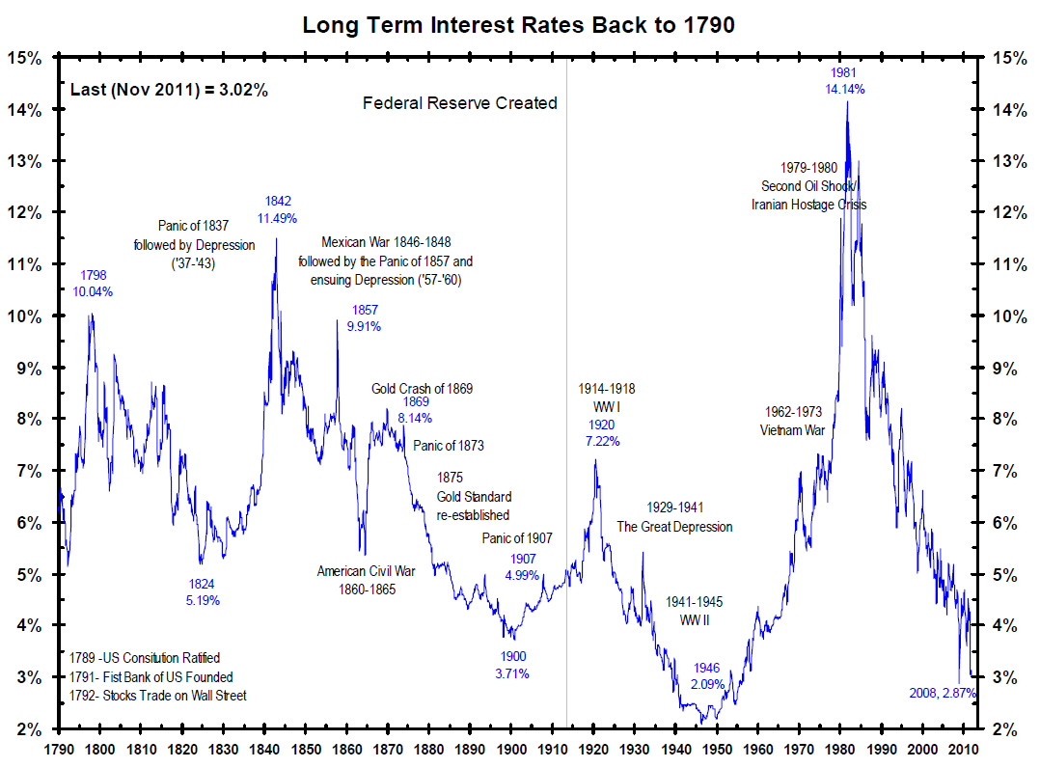

Slide 7
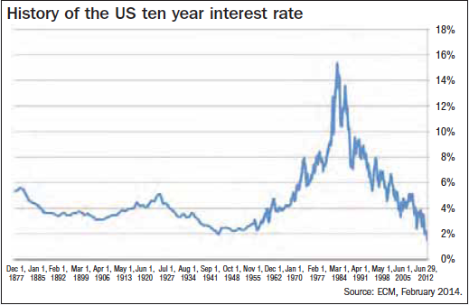

Slide 8
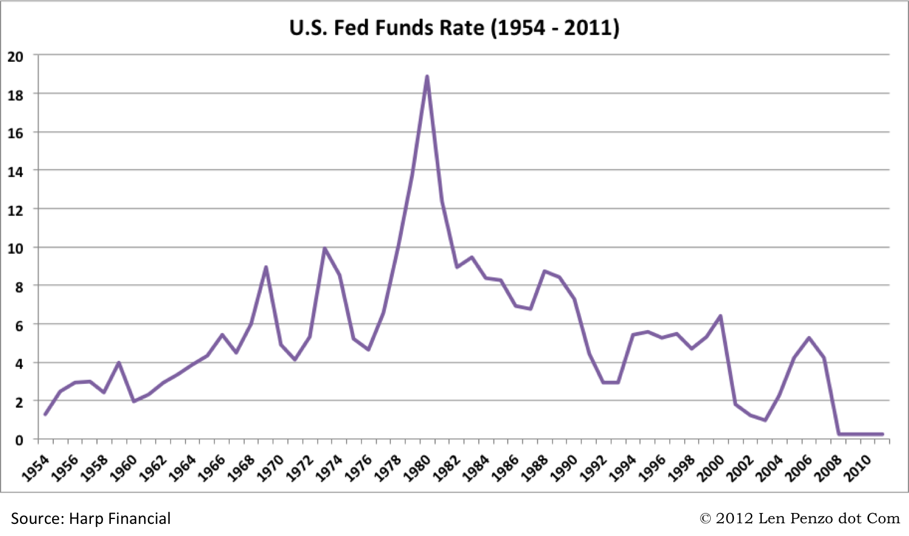

Slide 9
Modern Approach
Build a model for interest rate, then use this model to price bonds and interest rate derivatives
These models can be discrete time or continuous time
Some models model the spot rate directly, others model the forward rate instead.
This course focus on the discrete time approach. Specifically, we will learn various interest rate models in the binomial tree setting

Slide 10
In This Course
You expect to learn:
Spot rate models
Vasicek (general equilibrium model)
CIR(general equilibrium model)
HW I, II (general equilibrium model)
BDT(no arbitrage model, use the entire yield curve to model the spot rate movement)
Instantaneous forward rate models(modeling the entire yield curve, not just the spot rate)
HJM(no arbitrage model)
LIBOR market models (modeling a set of forward rates)
BGM(no arbitrage model)
You also get a chance to know lots of interest rate derivatives products
Swaps/futures/options/swaptions
Callable/convertible/caps/floors/range accrues/digitals/other exotics

Slide 11
Course Contents
HJM model (lecture)
Theory
Yield curve arbitrage
Derivatives pricing
Applications
Spot rate models (presentation)
V/CIR/HW model
BDT model
Market models (if time allows)
BGM model

Slide 12
Prerequisites
Probability theory
Sigma field/probability measure…
Stochastic process
Brownian motion
Martingale…
Basic understanding of the fixed income markets
Yield to maturity/forward rate
Duration/convexity
Treasury/munis/corporate bond/MBS/ABS…
Derivatives
Options/futures/forwards/swaps
Binomial option pricing model

Slide 13
Class meetings
14:30-16:10, Mondays @ Rm D136, Econ Building 10:10-11:50, Wednesdays @ Rm 2-105, Qunxian
Instructor: Qian Han, wise.hanqian@gmail.com
Office hour: 3-5pm, Fridays @ Rm A402
Lectures + article discussions/presentations
Guest lecturers?

Slide 14
NO Exams!
There will be several reading assignments
You need to present these readings in groups
Your final score for the course will be based on your attendance and class participation(30%), stochastic quizzes (30%) and your group presentations (40%)

Slide 15
References
Textbooks
Modeling Fixed-Income Securities and Interest Rate Options, second edition, Robert A. Jarrow
Interest rate models: theory and practice, Damiano Brigo and Fabio Mercurio
Reading assignments
Vasicek, O., 1977. An equilibrium characterization of the term structure, Journal of Financial Economics 5, 177-188;
Ho, T.S., and S. Lee, 1986. Term structure movements and pricing interest rate contingent claims. Journal of Finance 41, 1011-1028;
Heath, D., R. Jarrow, and A. Morton, 1990. Contingent claim valuation with a random evolution of interest rates. Review of Futures Markets 54-76;
Heath, D., R. Jarrow, and A. Morton, 1990. Bond pricing and the term structure of interest rates: a discrete time approximation. Journal of Financial and Quantitative Analysis 25(4), 419-440;
Heath, D., R. Jarrow, and A. Morton, 1992(a). Bond pricing and the term structure of interest rates: a new methodology for contingent claims valuation. Econometrica 60(1), 77-105;
Black, F., E. Derman, and W. Toy, 1990. A one-factor model of interest rates and its application to treasury bond options. Financial Analyst Journal 46, 33-39;
Cox, J., S. Ross and J. Ingersoll, 1985. A theory of the term structure of interest rates. Econometrica 53, 385-407;
Hull, J., and A. White, 1990. Pricing interest rate derivative securities. Review of Financial Studies 3(4), 573-592.
Hull, J., and A. White, 1994a
Hull, J., and A. White, 1994b
Brace, A., Gatarek, D. et Musiela, M. (1997): “The Market Model of Interest Rate Dynamics”, Mathematical Finance, 7(2), 127-154.

